Slide 1

Forest Cover Type Prediction with Machine Learning
Joel Pangilinan
Daniel Carrasco
Poonam FANDAN
Ra-cee Lucas
David Levy
Notes:
POONAM
Hello everyone! For our project, we decided to tackle a forestry classification task using a data set provided by Colorado State University and accessed through the UC Irvine Machine Learning Repository.
Essentially, we are using supervised learning techniques to build a model that can accurately predict what the primary type of tree is in any given 30x30 meter square in the Roosevelt National Forest in Northern Colorado.
Now that may seem a little niche, but we promise we’ll bring it around and give it some real-world meaning once we give you a sense of how we put this all together.

Slide 2


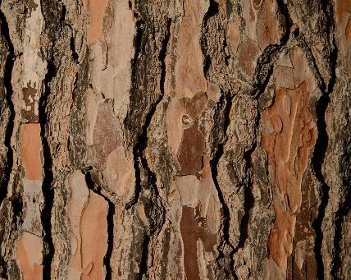

Presentation Overview
Applications
Objective & Data Set
Exploratory Data Analysis
ML Algorithm Intuition
Prediction Results
Conclusion
Notes:
POONAM
We’ll start by shedding a little more light on our motivations and explaining the nature of our data set without getting too bogged down in details. Obviously we don’t want to get into a situation where you can’t see the forest for the trees, as it were (haha).
Then we’ll give you a sense for what our data looks like through the output of our exploratory data analysis efforts.
Once we all know what we’re looking at, we can dive into the classification trials we ran and some intuition as to what each algorithm does.
We’ll tell you a bit about the best performance we were able to get from the models we tried—spoiler alert, the algorithms have a sense of humor on this topic. I’ll leave you to think about what we might mean by that.
And we’ll finish with an overview of the ways in which this model might be put to use in the real world.

Slide 3
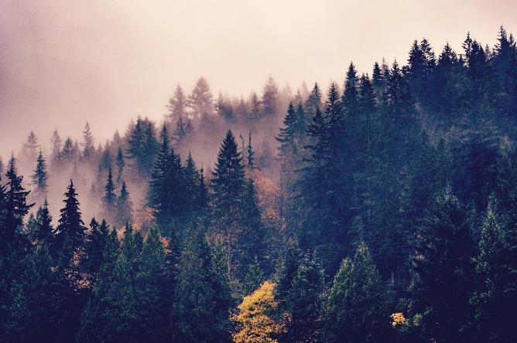


Forest Cover Types — Why?
If we understand what tree species predominate in relatively pristine wilderness areas, we can make better decisions about reforestation efforts as more nations, corporations and individuals set out to reintroduce forest into our landscapes.
Benefits
Carbon sinks
Flood and fire control
Improve livability of urban areas
Challenges
Cost
Time
Ecological health
Notes:
POONAM
Now we have some intuition as to what kinds of information are included in this data set, but it might not be immediately clear why we should care about the ability to predict forest cover types from cartographic variables. After all, ultimately if we can just go out and take pictures of the forest with drones or something, couldn’t we more easily classify that way?
Well sure, but what about areas where we have the cartographic information… but not the labeled data pertaining to cover type?
If we were to understand what tree species currently predominate in relatively pristine wilderness areas like the Roosevelt National Forest, that could help us figure out what types of trees used or could someday cover deforested areas where we’re seeing the most dramatic effects of the Anthropocene era.
Reforestation efforts have become a major aspect of national, corporate and individual responsibility, but ultimately if you don’t understand the land those efforts can be for naught.
That doesn’t mean reforestation is not important, though. Reforested areas act as carbon sinks, they aid in flood and fire control, and they can even improve the livability of urban areas. That said, if people are going to throw money and time at reforestation efforts, we want to make sure that the cost and time to effect are minimal, and that the ecological benefits are maximal.
And that’s why ML models like the one we’ve constructed here matter.

Slide 4

Data Set Overview
Features
Target
Elevation (m)
Aspect (º azimuth)
Slope (º)
Horizontal Distance to Hydrology
Vertical Distance to Hydrology
Horizontal Distance to Roadways
Hillshade 9am
Hillshade 12pm
Hillshade 3pm
Horizontal Distance to Fire Point
Wilderness Area
Soil Type
Cover Type:
1 – Spruce/Fir
2 – Lodgepole Pine
3 – Ponderosa Pine
4 – Cottonwood / Willow
5 – Aspen
6 – Douglas-Fir
7 – Krummholz
Notes:
RA-CEE
Okay, like I said, we are dealing with a supervised learning classification task here. How do we know? Well, we have labeled data, where the target attribute is the predominant type of tree growing in a 30x30 m patch of forest. All of the non-target attributes fall into one of the categories listed on the left side of this slide.
So clearly, we have a discrete target variable and then both continuous and categorical data.
For instance, elevation would be continuous where Wilderness Area and Soil Type fields are binary categorical indicating which of 4 wilderness areas the patch is in and which of 40 soil types are present.
One important thing to note here, all of these variables are what we call cartographic variables, so they’re all information that can be gleaned from maps – either topographical maps that help us understand features of the land, or specialty maps constructed by the U.S. Geological Survey to keep track of things like the wilderness area and soil types over forested land in the U.S.
The second important thing is that the cover type target attribute was determined using U.S. Forest Service Resource Information System data.

Slide 5









Tools We Used
Preprocessing
Visualization
Machine Learning
Notes:
Racee

Slide 6
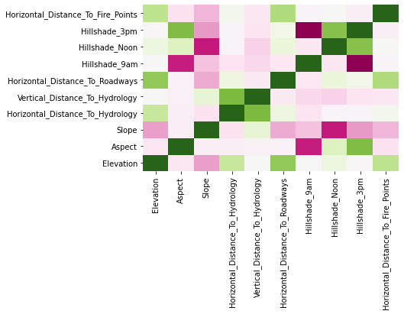
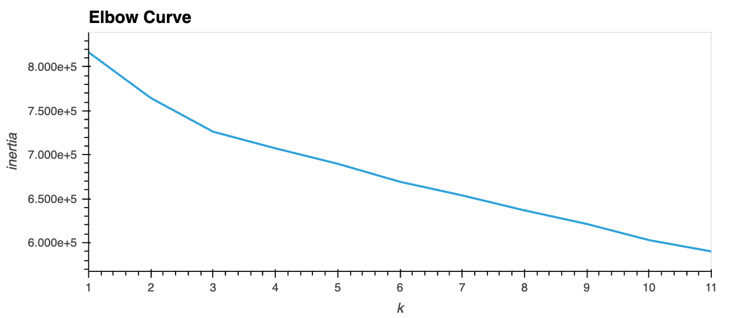
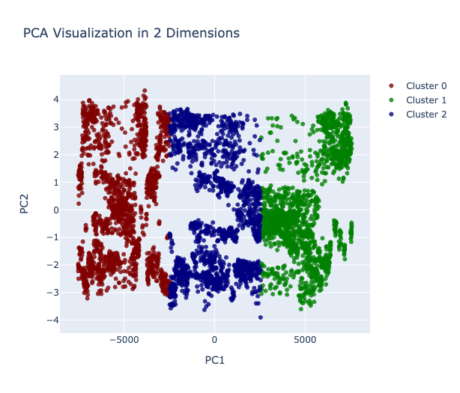
Exploratory Data Analysis
Elevation
Aspect
Horizontal Distance to Hydrology
Slope
Vertical Distance to Hydrology
Horizontal Distance to Roadways
Hillshade 9am
Hillshade Noon
Hillshade 3pm
Horizontal Distance to Fire Points
Notes:
Thanks, Racee. And hi, everybody!
We don’t want you looking at our results not knowing what went on in the black box, as it were. So there are two topics I’m going to walk you through.
First we’ll briefly touch on our exploratory data analysis and feature engineering
and second I’ll aim to give you a little high-level intuition for the machine learning algorithms we tried out, which I think is very important because it’s easy to plug and chug these packages without thinking too deeply
EDA:
So here are our continuous features, obviously with a range of normal and non-normal distributions, and with pretty substantial correlation between some features as you can see from the matrix here.
Importantly, as Ra-cee discussed, one of the features not shown here is region, which is geographic in nature, but described categorically, and not geocoded. So a big takeaway for us was that we might have significant challenges with multicollinearity because of spatial correlations that we can’t necessarily parse out.
In the end, that means there’s some scaling, some transformations, and some feature engineering to handle with this dataset, which might benefit from some principal component analysis and importance calculations as well.
One thing we thought we’d try just for kicks is a clustering exercise on the feature matrix. An elbow curve showed us an ideal of 3 clusters, which obviously doesn’t match the 7 classes we’re trying to sort into. Now that doesn’t necessarily say anything specific about how supervised learning will go, but we thought it might be a sign that accuracy could be low.
That said, let’s move on and talk about algorithms we picked.

Slide 7

ML Algorithms
Logistic Regression
Bagging Classifier
Random Forest
Gaussian Naïve Bayes
Intuition
A simple linear classification algorithm that makes a categorical prediction based on mapping probabilities to predicted labels given numerical inputs using a sigmoid curve.
Pros:
Low risk of overfitting with regularization
Highly interpretable
Softmax or one-vs-rest can be used for multinomial
Cons
Assumes linearity
Overfitting possible with small high-dimensional data
Notes:
So logistic regression, we’ve probably all seen before. In the simple binomial case, we have that classic sigmoid, S-shaped curve that’s fit to the training data to give us a cleanly defined cutoff for classification.
The nice thing is that the nature of a logistic classification system makes it really hard to overfit, and also makes the model pretty easy to interpret in comparison to other machine learning models.
Also there are intuitive extensions to the multinomial case. So for instance, our 7-class task used the out-of-the-box scheme from sci-kit learn’s logistic regression training model, which is one-versus-rest approach. Meaning that each class gets treated separately and compared to the others in aggregate with a binomial logistic regression, and the relative strength of each classification gives us the extra detail we need to decide specifically which class a new data point belongs to.
The bad news is that we have to assume linearity of the data, which very likely is not reasonable here because we’re dealing with geographic data that tends to have heavy correlation issues.

Slide 8
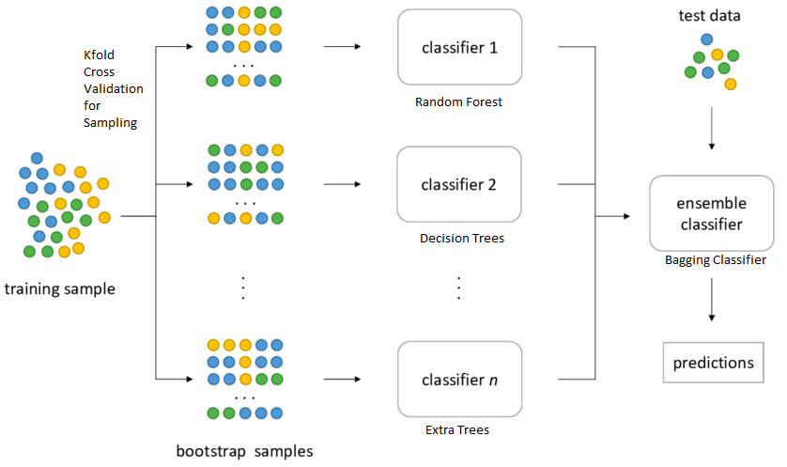
ML Algorithms
Logistic Regression
Bagging Classifier
Random Forest
Gaussian Naïve Bayes
Intuition
An ensemble learning technique that relies on bootstrap aggregations to produce a more accurate output than base learners would be on their own, essentially leveraging the ‘wisdom of crowds’.
Pros:
Low risk of overfitting
Flexibility
Easy to determine feature importance
Cons
Underfitting is a distinct possibility
Loss of interpretability
Relatively expensive, in terms of computing power
Notes:
Bagging classifiers are interesting because they employ something called ensemble learning, which essentially means that we’re going to use bootstrapping (or row sampling with replacement) to train many weak learners and aggregate them to get a “wisdom of crowds” effect. And then majority rule should help us yield more accurate results on the whole. Now again, we have low risk of overfitting because this process reduces variance in the data. And we have an added benefit of flexibility over logistic regression.
Super important, though. This is where we start to see a loss of interpretability and an increase in the computing power required, just because there so much more going on under the hood as we follow the bootstrapping procedure.

Slide 9
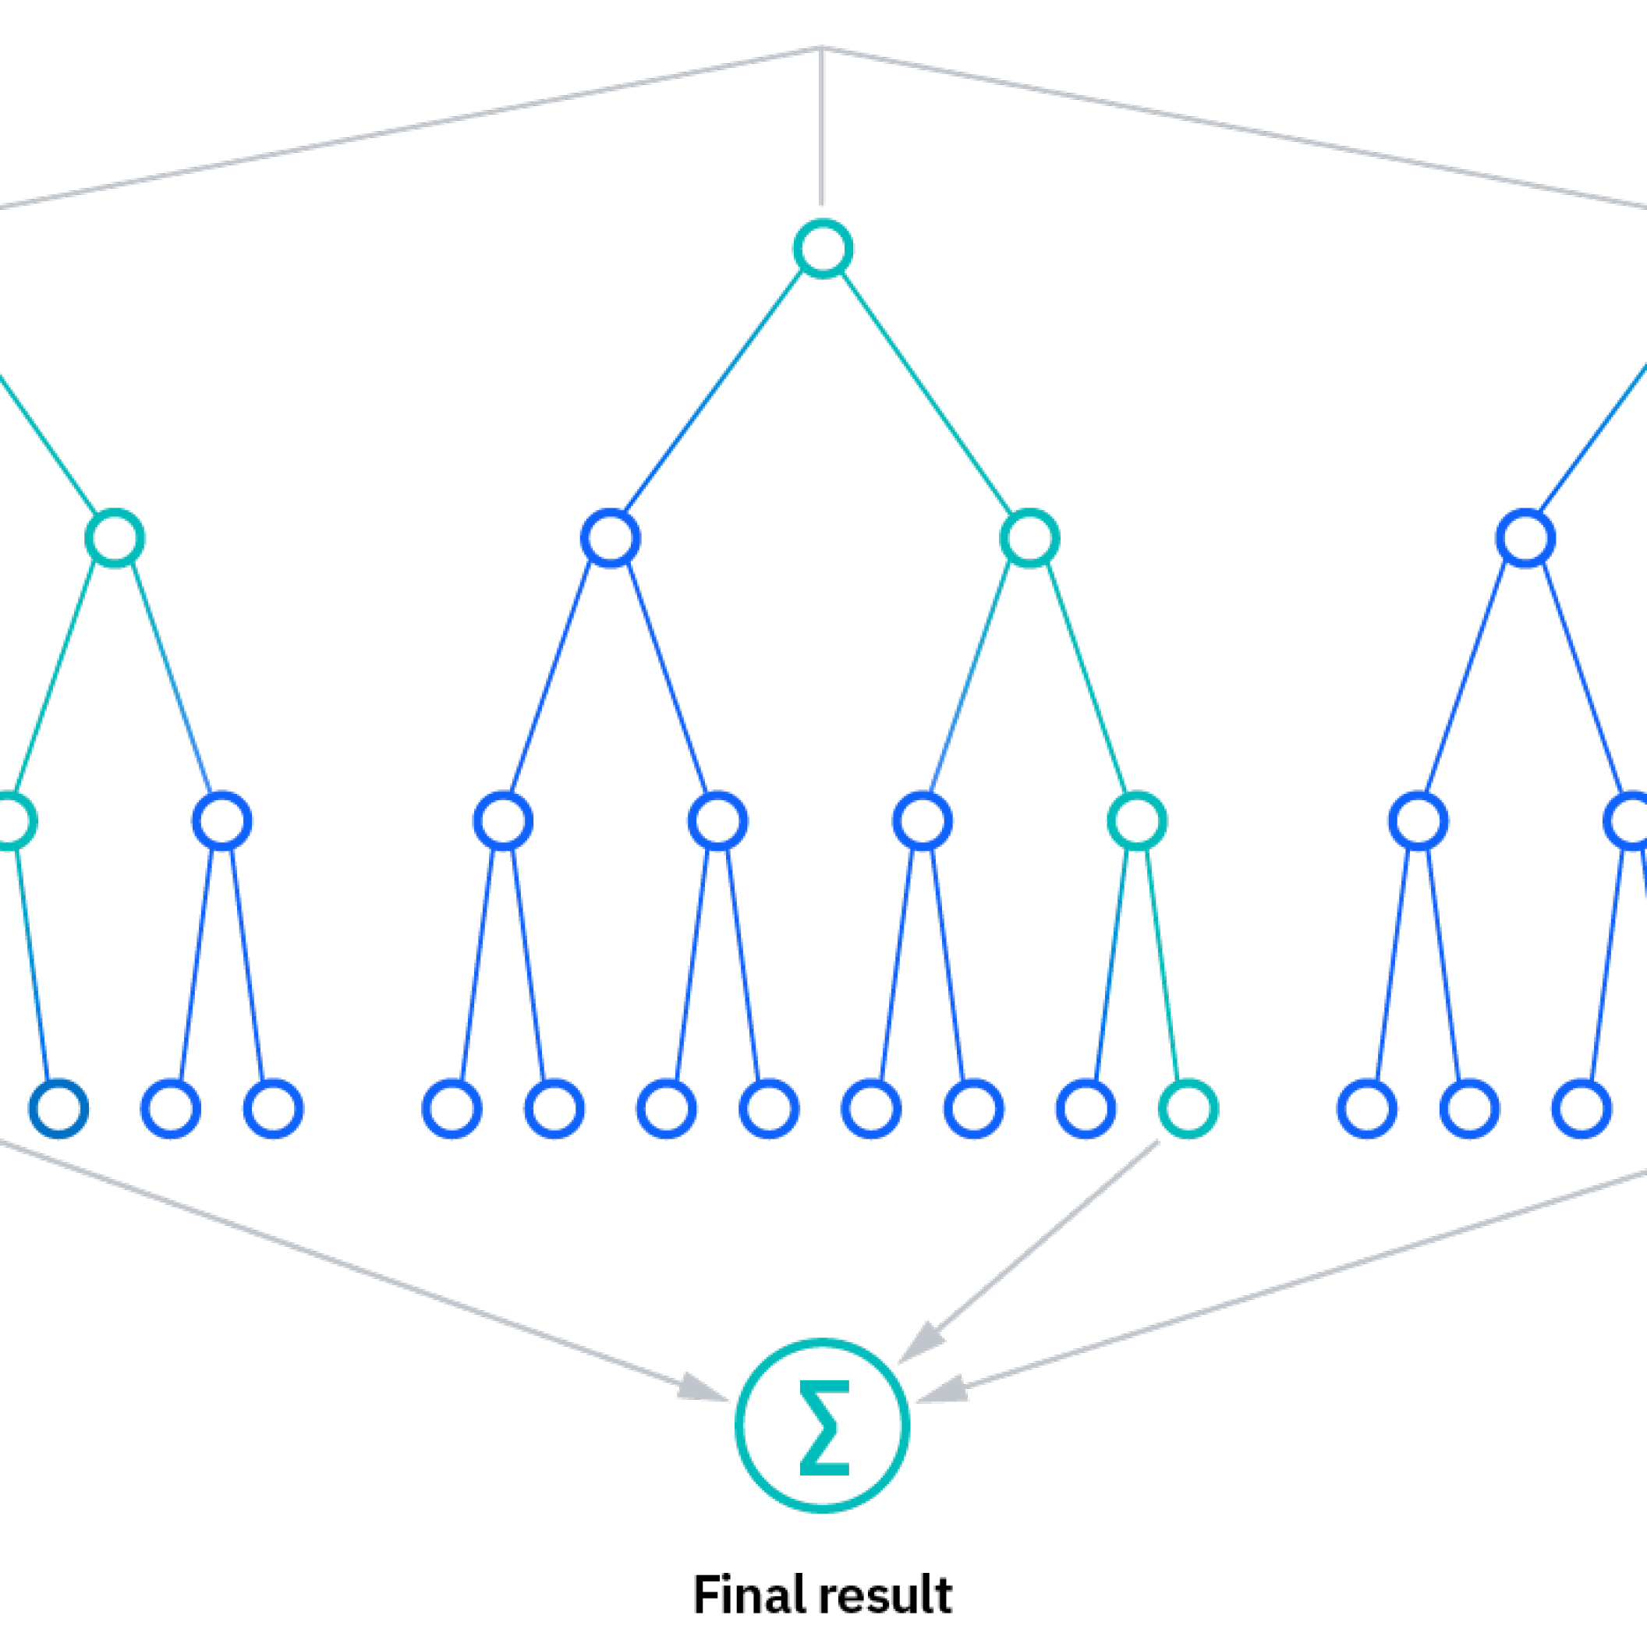
ML Algorithms
Logistic Regression
Bagging Classifier
Random Forest
Gaussian Naïve Bayes
Intuition
A tree-based extension of the bagging principle that combines multiple decision trees using feature subsets to produce a single categorical output.
Pros:
Low risk of overfitting
Flexibility
Easy to determine feature importance
Cons
Low interpretability
High training complexity
Time-consuming with large data
Notes:
Random forest is just an extension of the bagging classifiers I just talked about, and I think the major notable difference is that in random forest, we use bagging to create a LOT decision trees that are also using randomized subsets of the feature matrix. So not every tree is grown using all of the available information, and that actually improves the independence of each tree, which is likely to get us a fairer aggregated vote and produce even more accurate predictions.
Other than that we have basically the same pros and cons. But we couldn’t NOT include a random forest approach, because, I mean look at the topic of our project.

Slide 10
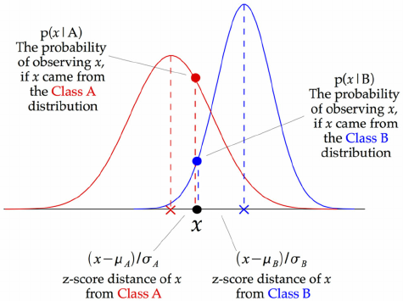
ML Algorithms
Logistic Regression
Bagging Classifier
Random Forest
Gaussian Naïve Bayes
Intuition
A probabilistic algorithm that relies on the concept of conditional probability and assumes normality of continuous variables. Decoupling
Pros:
Fast
Surprisingly accurate
Low emphasis on dimensionality
Cons
Unrealistic assumptions
Not particularly flexible
Notes:
Gaussian naïve bayes is probably the most stats-heavy in terms of the intuition behind it, so I’m going to keep it very light. The important thing to know is that Gaussian refers to the idea that our features are normally distributed, naïve refers to the assumption that features are all independent, and Bayes refers to the idea that we’re reliant on conditional probability. So what happens is we take a prior derived from the training data and produce a score by taking into account the likelihood that the new data point falls where it does on each feature distribution independently GIVEN that the data point comes from each class. Then we compare scores and give a prediction on that basis.
Now the beautiful thing is that this algorithm is fast, computationally inexpensive, and surprisingly accurate because it turns out that noise from the normality assumption actually sort of cancels when you aggregate over the feature set. There’s this idea in statistics that the normal distribution has some magic to it, and this is just another instance in which that turns out to be pretty true. The paper I read about that was super complicated and I only followed about half of it, but it boiled down to there being mathematical justification for this working even though the assumptions are unrealistic.
So we thought these four algorithms would be a good set to try out with our classification task. And now I’ll pass it to Daniel to explain what we saw.

Slide 11
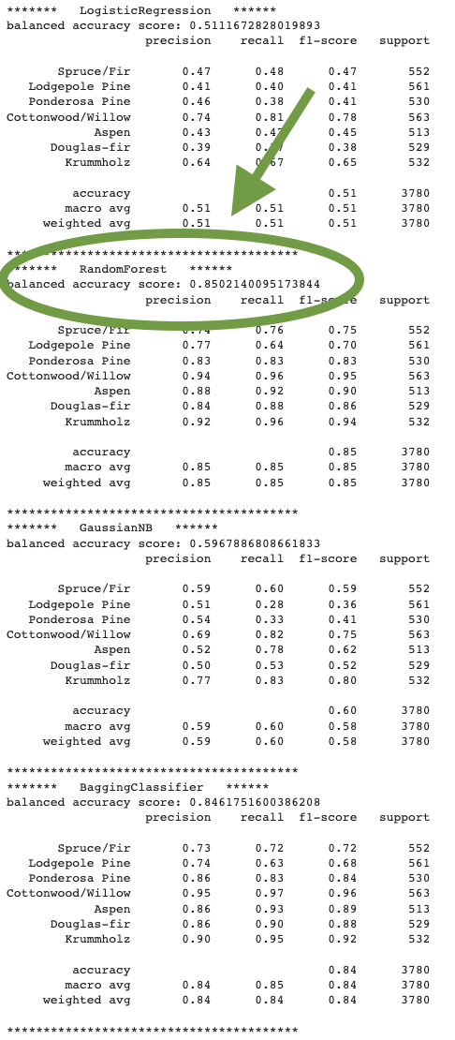
Results
Algorithm | Accuracy
Random Forest | 85.02%
Bagging Classifier | 84.62%
GaussianNB | 59.68%
Logistic Regression | 51.11%
Notes:
Daniel

Slide 12
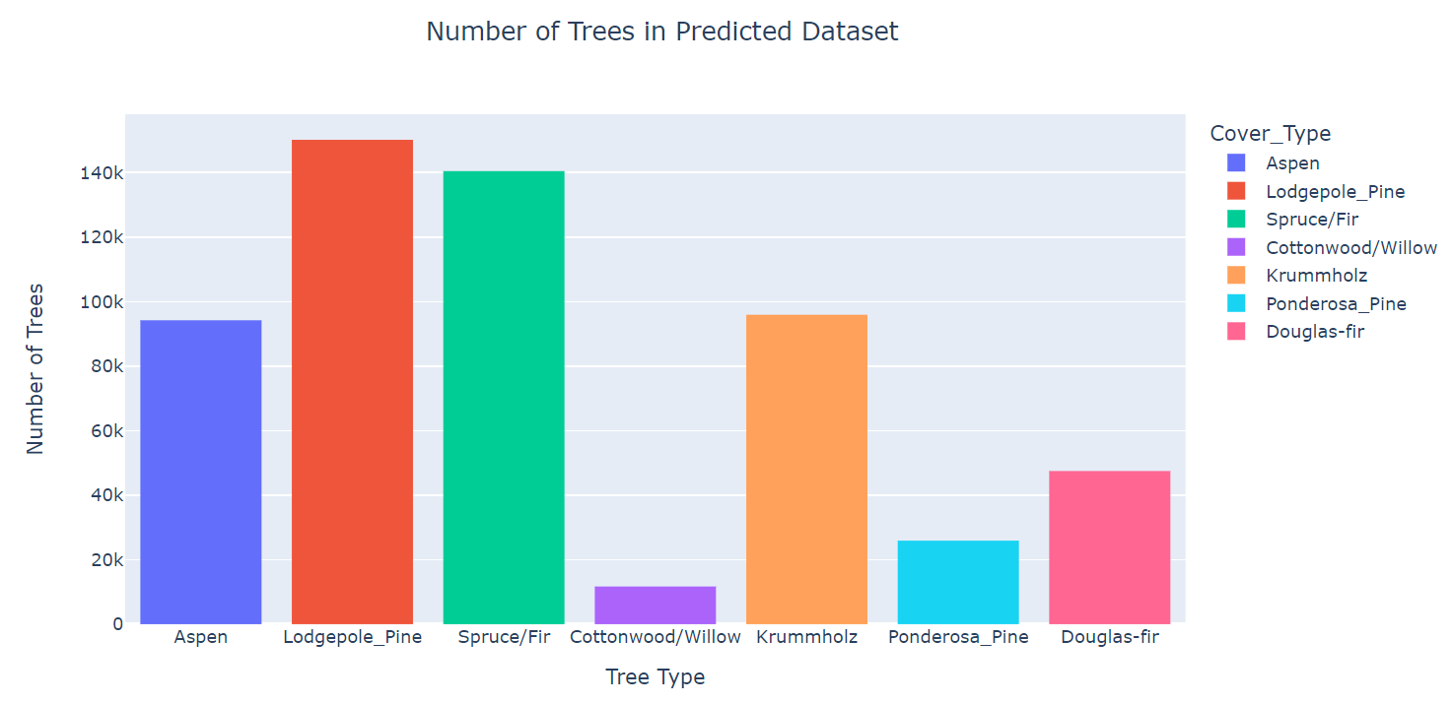
Results – Number of Trees by Cover Type
Notes:
Explanation: This visualization displays the distribution of tree cover types found in our predicted dataset. By analyzing this distribution, we can gain insights into the dominant tree cover types present in the dataset.
Lodgepole_Pine as the predominant cover type in the study area and Cottonwood/Willow as being the smallest.
Key Takeaway: The distribution of tree cover types provides valuable insights into the composition of the dataset and can aid in understanding the vegetation patterns and characteristics of the study area.
******************************************************
Slide 1: Number of Trees by Cover Type
Title: Distribution of Tree Cover Types
Explanation: This visualization displays the distribution of tree cover types found in our predicted dataset. By analyzing this distribution, we can gain insights into the dominant tree cover types present in the dataset.
Key Observations:
Cover Type ??: Lodgepole Pine - This cover type appears to be the most abundant in the dataset, as it has the highest count among all cover types.
Cover Type ??: Spruce/Fir - Spruce/Fir also represents a significant portion of the tree cover in the dataset.
Cover Type ??: Krummholz and Aspen - Krummholz another prominent cover type, although it is less prevalent compared to Spruce/Fir and Lodgepole Pine.
Cover Types 4-7: These cover types exhibit relatively lower counts compared to the aforementioned types, suggesting they are less common in the dataset.
Understanding the distribution of tree cover types is crucial for further analysis and decision-making in areas such as forestry management, ecological studies, and land-use planning.
Key Takeaway: The distribution of tree cover types provides valuable insights into the composition of the dataset and can aid in understanding the vegetation patterns and characteristics of the study area.
On our first visualization, I’m showing here the number of cover types across all four wilderness areas.
***********************************

Slide 13
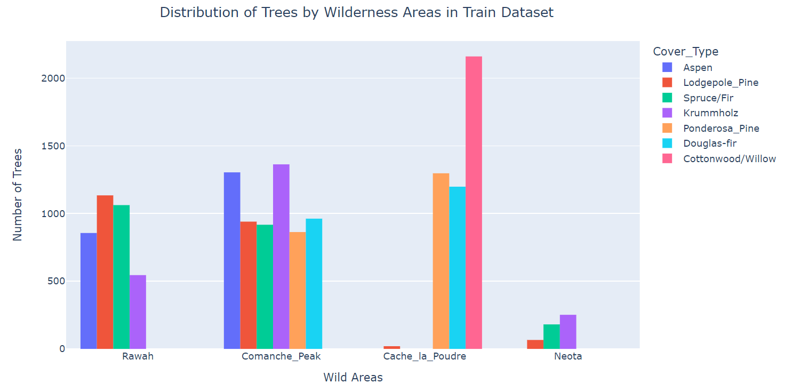
Results – Distribution of Cover Types by Wilderness Areas
Notes:
Slide 2: Distribution of Cover Types by Wilderness Areas
Title: Cover Types Across Wilderness Areas
Explanation: This visualization explores the relationship between the wilderness areas and the distribution of cover types. Wilderness areas are specific regions characterized by their unique environmental and geographical features.
Key Observations:
Wilderness Area 1: This area shows a diverse range of cover types, including Spruce/Fir, Lodgepole Pine, Ponderosa Pine, Cottonwood/Willow, Aspen, and Douglas-fir. It has a relatively higher count of Spruce/Fir and Lodgepole Pine compared to other cover types.
Wilderness Area 2: The dominant cover type in this area is Spruce/Fir, followed by Lodgepole Pine and Aspen. Other cover types appear to have lower representation.
Wilderness Area 3: Spruce/Fir and Lodgepole Pine are the prominent cover types in this area, with Spruce/Fir being more abundant. The other cover types are less prevalent.
Wilderness Area 4: This area primarily consists of Spruce/Fir and Lodgepole Pine cover types, with Spruce/Fir being the more dominant of the two.
This visualization provides insights into the relationship between wilderness areas and the composition of tree cover types within each area. Understanding this distribution can assist in ecosystem analysis, conservation efforts, and determining suitable management strategies for different wilderness areas.
Key Takeaway: The distribution of cover types across different wilderness areas provides valuable information about the vegetation characteristics specific to each area. Understanding these patterns can aid in assessing the ecological diversity and management needs of different wilderness areas.

Slide 14
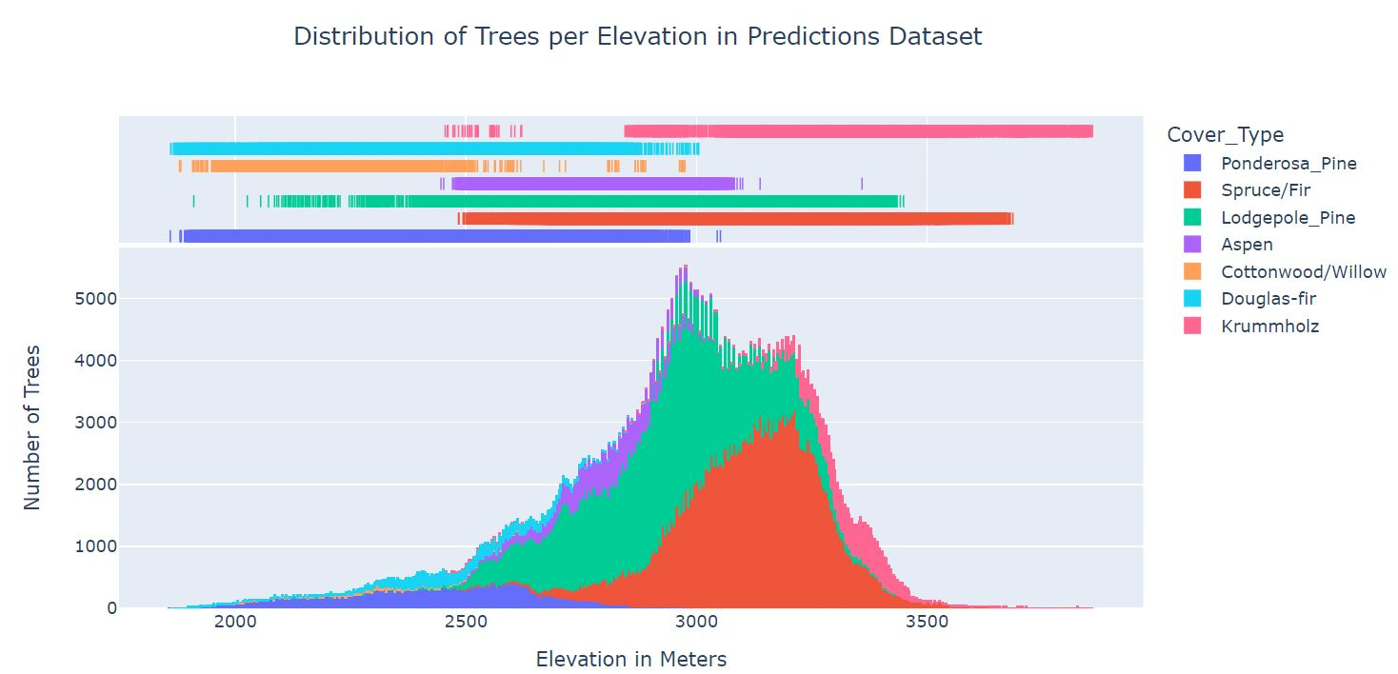
Results – Distribution of Cover Types by Elevation
Notes:
Slide 3: Distribution of Cover Types by Elevation
Title: Cover Types Across Elevation Levels
Explanation: This visualization examines the distribution of tree cover types across different elevation levels. The x-axis represents the elevation values, while the y-axis represents the count of each cover type corresponding to the respective elevation range.
Key Observations:
Lower Elevation Ranges: At lower elevation levels, the dominant cover types are Cottonwood/Willow, Aspen, and Douglas-fir. These cover types are typically associated with lower-lying areas.
Mid to High Elevation Ranges: As the elevation increases, the dominant cover types transition to Spruce/Fir, Lodgepole Pine, Ponderosa Pine, and other coniferous species. These cover types thrive at higher altitudes and exhibit a significant presence in the dataset.
Transition Zones: In certain elevation ranges, there may be overlap or coexistence of different cover types, indicating ecotones or transitional areas between distinct vegetation zones.
Analyzing the distribution of cover types with respect to.
Key Takeaway: The distribution of cover types with respect to elevation provides insights into the preferences and adaptability of different tree species to specific altitude ranges. Understanding these relationships is crucial for studying ecological patterns and predicting vegetation changes across varying elevations.

Slide 15
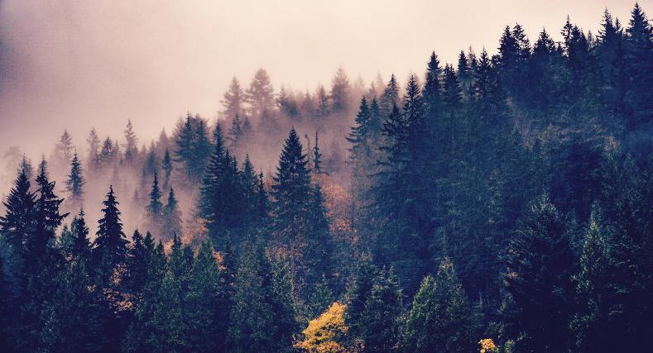

Summary
A random forest approach proved to maximize the accuracy of our supervised learning classification task of predicting forest cover type from cartographic variable inputs. These measurements could easily be obtained for currently deforested areas, and we hope that our contributions could help inform reforestation policy to improve costs and time-to-benefit of such programs.
Notes:
Daniel

Slide 16

Thank you
Joel Palinginan
Daniel Carrasco
Poonam Fandan
Ra-cee Lucas
David Levy

